Slide 1
A SELF-LEARNING METAHEURISTIC FRAMEWORK BASED ON REINFORCEMENT LEARNING FOR COMBINATORIAL PROBLEM
Marcelo Becerra Rozas imaberro90@gmail.com
Facultad de Ingeniería Escuela de Ingeniería Informática
Examen de Grado - Candidatura
Valparaíso, Enero 2022

Slide 2
Context
Why solve combinatorial optimization problems?
Notes:
Hoy en día, los problemas combinatoriales en dominios binarios
se presentan de manera muy frecuente en las problemáticas de la industria,
por lo que resolverlos de manera eficiente es prioridad tanto en el área académica como industrial.
En este contexto las Metaheurísticas han tomado protagonismo.

Slide 3
Why apply metaheuristics to solve combinatorial optimization problems?
Context
Notes:
Las Metaheurísticas tienen la capacidad de explorar y explotar el espacio de búsqueda,
donde la exploración es el proceso de visitar nuevas regiones del espacio de búsqueda,
mientras que la explotación es el proceso de visitar aquellas regiones dentro del vecindario de las soluciones previamente visitadas.
Para tener éxito, una Metaheurística debe establecer una buena relación entre la exploración y la explotación.

Slide 4
Context
Why apply metaheuristic binarization techniques?

Slide 5
Context
Why apply a smart selector?
Notes:
Para realizar esta adaptación es necesario utilizar un esquema de binarización, para así aprovechar los movimientos originales de las Metaheurísticas diseñadas para espacios continuos.
Sin embargo, esta adaptación con el esquema a utilizar es manual, es decir,
los resultados y la comparación con otro esquema es al dar con la condición de término.
Al utilizar un selector inteligente no solo obtenemos información interesante al respecto de la selección, si no que nos aseguramos de estar eligiendo el mejor esquema en el estado de la metaheurística.

Slide 6
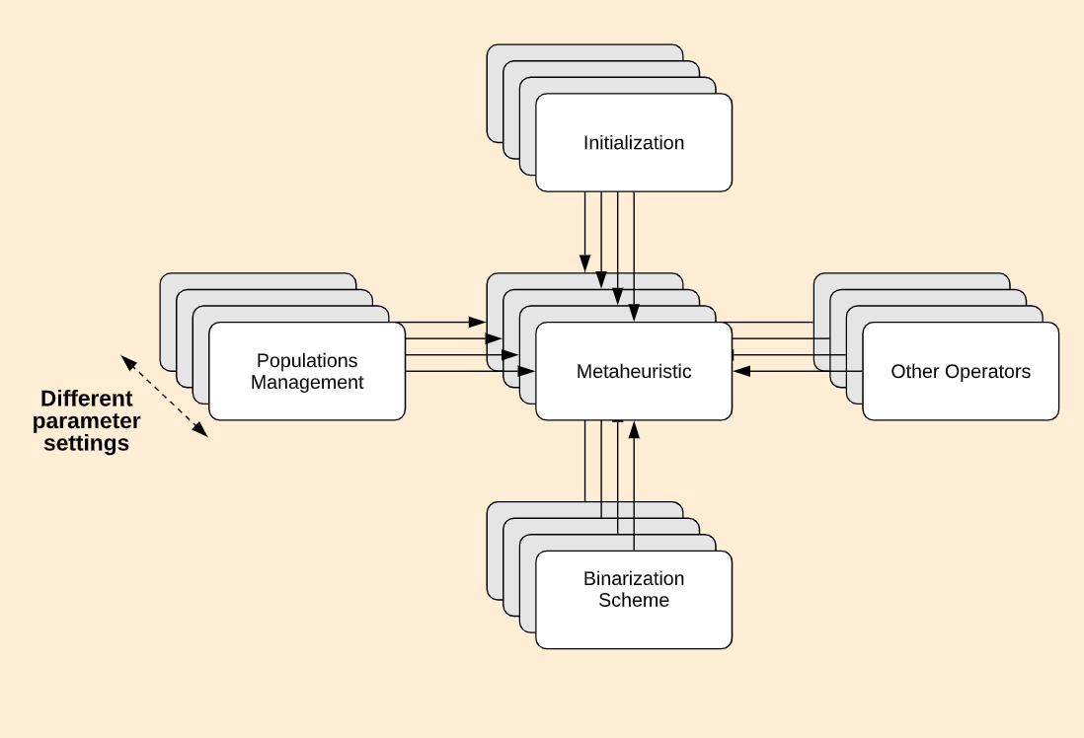
Main Objective
Develop a framework that compiles various reinforcement learning techniques in swarm-based metaheuristics by selecting binarization schemes to solve combinatorial problems. In turn, making different adjustments, such as reward functions, operators and metrics.
Notes:
Desarrollar un marco de trabajo que recopile diversas técnicas de aprendizaje por refuerzo en metaheurísticas basadas en enjambres, seleccionando esquemas de binarización para resolver problemas combinatorios binarios. Realizando a su vez, diferentes ajustes, como funciones de recompensa, operadores, funciones de transferencia, técnicas de binarización.

Slide 7
Specific Objectives
Generate a collection of techniques to improve the solution quality of swarm-based metaheuristics when solving combinatorial problems.
Implement various reinforcement learning techniques in swarm-based metaheuristics that allow autonomous selection of binarization schemes.
Compare the results of the different techniques implemented and demonstrate the quality of their solutions.

Slide 8
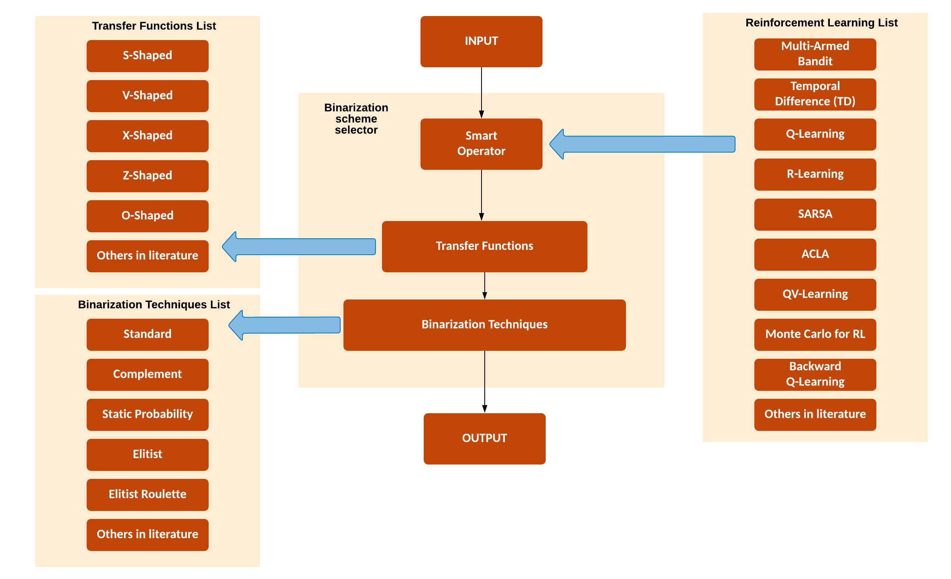
Proposal

Slide 9
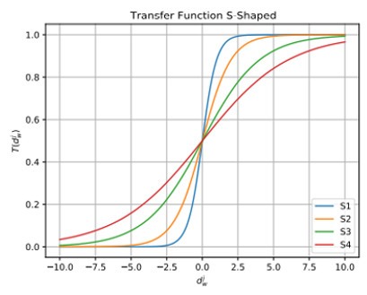
S-Shaped

Slide 10
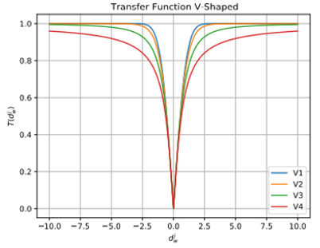
V-Shaped

Slide 11
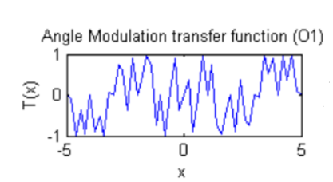
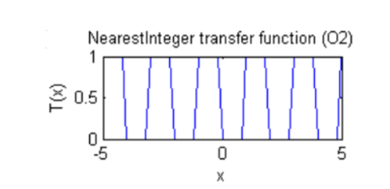
O-Shaped
Pampara, G., Franken, N., & Engelbrecht, A. P. (2005, September). Combining particle swarm optimisation with angle modulation to solve binary problems.
Costa, M. F. P., Rocha, A. M. A., Francisco, R. B., & Fernandes, E. M. (2014). Heuristic-based firefly algorithm for bound constrained nonlinear binary optimization.

Slide 12
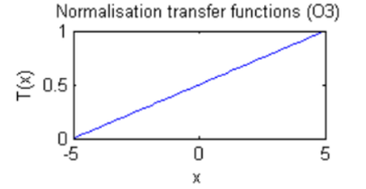
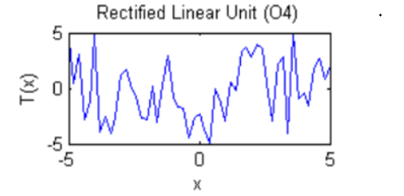
O-Shaped
Pampará, G., & Engelbrecht, A. P. (2011, April). Binary artificial bee colony optimization.
Zhu, H., He, Y., Wang, X., & Tsang, E. C. (2017). Discrete differential evolutions for the discounted {0-1} knapsack problem.

Slide 13
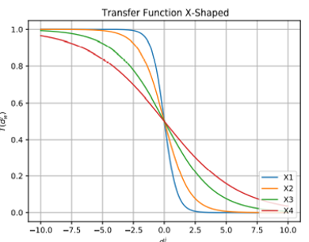
X-Shaped
Ghosh, K. K., Singh, P. K., Hong, J., Geem, Z. W., & Sarkar, R. (2020). Binary social mimic optimization algorithm with x-shaped transfer function for feature selection.
Beheshti, Z. (2021). A novel x-shaped binary particle swarm optimization.

Slide 14
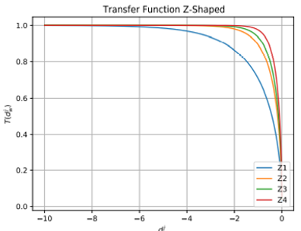
Z-Shaped
Guo, S. S., Wang, J. S., & Guo, M. W. (2020). Z-shaped transfer functions for binary particle swarm optimization algorithm.
Sun, W. Z., Zhang, M., Wang, J. S., Guo, S. S., Wang, M., & Hao, W. K. (2021). Binary Particle Swarm Optimization Algorithm Based on Z-shaped Probability Transfer Function to Solve 0-1 Knapsack Problem.

Slide 15
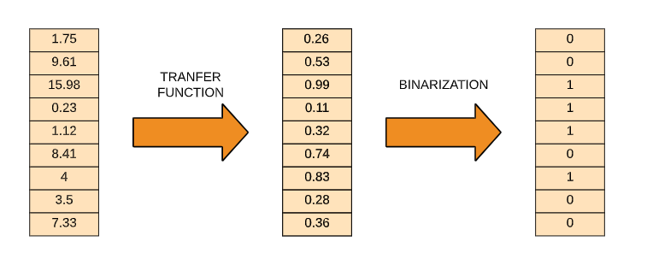
Binarization Scheme

Slide 16
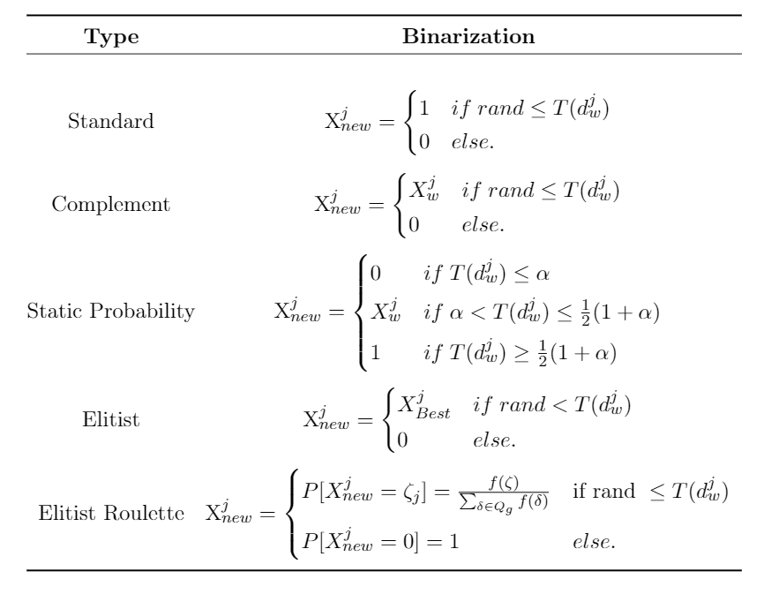
Binarization Technique

Slide 17
Metaheuristics implemented

Slide 18
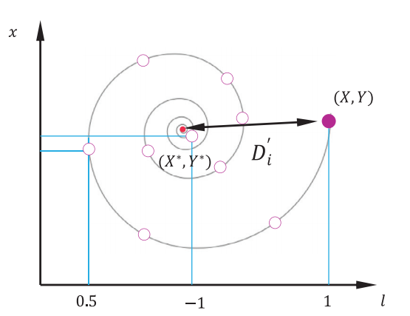
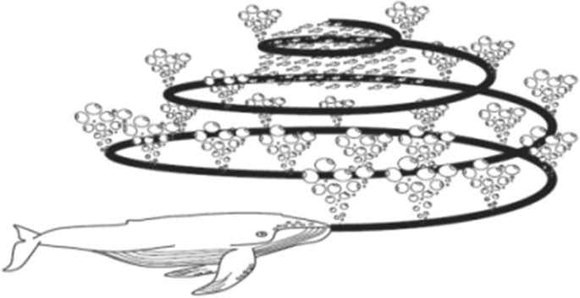
Whale Optimization Algorithm (WOA)
It is a population-based metaheuristic that is inspired by the behavior of groups of whales, which have a particular hunting strategy based on bubbles.
Mirjalili, S., & Lewis, A. (2016). The whale optimization algorithm.

Slide 19
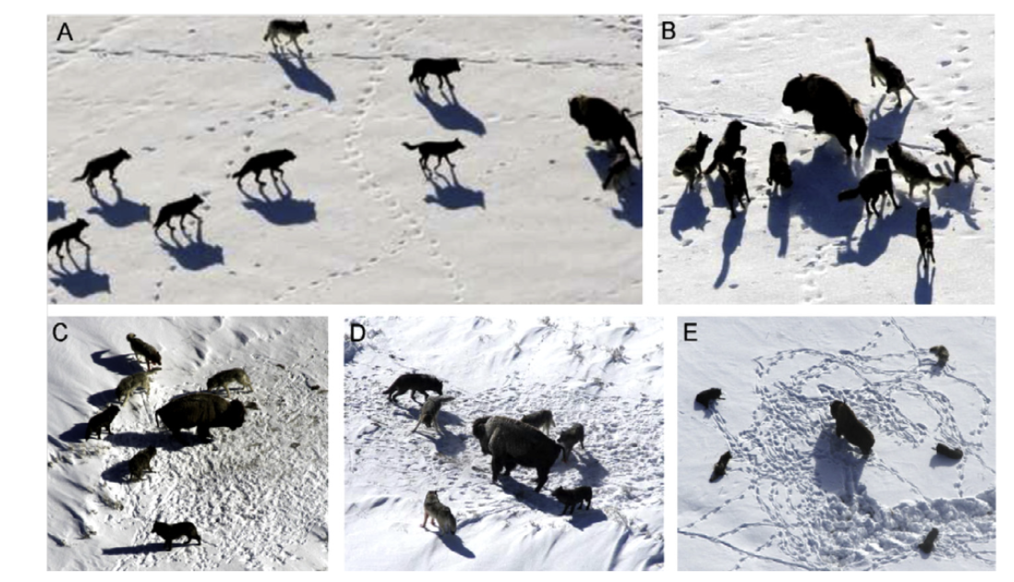
Grey Wolf Optimization (GWO)
It is a population-based metaheuristic that is inspired by the behavior of gray wolves and their hierarchy when searching for and hunting their prey.
A. Pursuit, approach and tracking
B-C-D. Tracking, harassing and encircling.
E. Atack
Mirjalili, S., Mirjalili, S. M., & Lewis, A. (2014). Grey wolf optimizer.

Slide 20
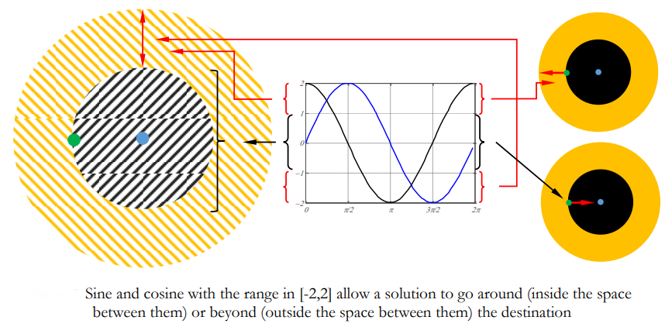
Sine-Cosine Algorithm (SCA)
Population-based metaheuristic inspired by the fluctuation that solutions have when following a mathematical model based on sine and cosine functions.
Mirjalili, S. (2016). SCA: a sine cosine algorithm for solving optimization problems.
Notes:
Metaheurística basada en la población e inspirada en la fluctuación que tienen las soluciones al seguir un modelo matemático basado en funciones seno y coseno.

Slide 21
Machine Learning

Slide 22
Q-Learning Equation
Select the maximum action
$$Q_{n}\left(s_{t},a_{t}\right)=Q_{n−1}\left(s_{t−1},a_{t−1}\right)+α[r_{n}+ γ⋅{\max_{a} Q}_{n+1}\left(s_{t+1},a_{t+1}\right)−Q_{n}(s_{t},a_{t})]$$
Previous value
Learning factor($α$):
Indicates the importance of the information previously obtained.
$α∈(0,1)$
Reward($r_{n}$):
Indicates the penalty or reward value of the action.
$r_{n}∈ ℝ$
Discount factor($γ$):
It functions as a scaling factor to reward or punish in the current action.
$γ∈(0,1)$

Slide 23
SARSA Equation
Discount factor
$$Q_{n}\left(s_{t},a_{t}\right)=Q_{n−1}\left(s_{t−1},a_{t−1}\right)+α[r_{n}+ γ⋅Q_{n+1}\left(s_{t+1},a_{t+1}\right)−Q_{n−1}(s_{t−1},a_{t−1})]$$
Previous Value
Reward
Value of the following state
Learning factor($α$):
Indicates the importance of the information previously obtained.
$α∈(0,1)$
Reward($r_{n}$):
Indicates the penalty or reward value of the action.
$r_{n}∈ ℝ$
Discount factor($γ$):
It functions as a scaling factor to reward or punish in the current action.
$γ∈(0,1)$

Slide 24
Backward Q-Learning
It is a structure where the action is directly affected, while the policy is indirectly affected.
Improve the speed of learning.
Increse the precise knowledge.
$$Q_{n}\left(s_{t}^{i},a_{t}^{i}\right)=Q\left(s_{t}^{i},a_{t}^{i}\right)+α[r_{t+1}^{i}+ γ⋅maxQ\left(s_{t}^{i},a_{t}^{i}\right)−Q(s_{t}^{i},a_{t}^{i})]$$
$$Q_{n}\left(s_{t}^{j},a_{t}^{j}\right)=Q\left(s_{t}^{j},a_{t}^{j}\right)+α[r_{t+1}^{j}+ γ⋅maxQ\left(s_{t}^{j},a_{t}^{j}\right)−Q(s_{t}^{j},a_{t}^{j})]$$
$$j=N, N−1, N−2, …, 1.$$
$$M^{i}←s_{t}^{i},a_{t}^{i},r_{t}^{i},s_{t+1}^{i}$$
Notes:
No sé si recuerdan en el examen de grado de Doctor de José Lemus, uno de los profesores de la comisión preguntó si es que, en la estructura que proponía Lemus, QL y SARSA trabajaban juntos. Bueno, en esta técnica trabajan juntos. Backward QL, a pesar de que tiene un nombre parecido a QL, no se parecen “mucho”, vamos a dejarlo con comillas. esta vez se realiza una actualización hacia atrás y se van guardando ciertos eventos, no es como la actualización QL ordinaria donde apenas se dejaba llevar por su aprendizaje pasado, si no que intentaba buscar siempre el óptimo. Podríamos decir, que ahora es más inteligente, gracias al trabajo en conjunto con SARSA
Y esto es básicamente por su estructura, ahora, la acción se ve afectada directamente, mientras que la política se ve afectada de forma indirecta, de esta forma, a medida que el agente aumenta la interacción con el entorno, el conocimiento preciso del agente también aumenta. También puede mejorar su velocidad de aprendizaje, equilibrar el dilema exploración-explotación y converger al mínimo global ¿Cómo?, utilizando aquellos estados, acciones e información anteriores.
Ahora, ustedes deben preguntarse, oye, pero no se supone que todos hacen lo mismo?, hacen algo cierto, luego evalúan eso que hicieron con la recompensa (si es que lo hicieron bien o mal) y después vuelven a trabajar?, Si, es correcto, sin embargo, la estructura que presenta Backward Q-Learning, hace algo interesante. Los autores se dijeron, ¿Porqué no hacemos algo parecido a lo que se hace con redes neuronales?, ¿Por qué no hacemos una especie de Backpropagation pero con nuestro QL?. Ellos lo que hacen es elegir una cantidad de iteraciones, supongamos 100, y una vez llegada a esa iteración, empiezan a actualizar hacia atrás la función Q. Entonces para este caso, nuestra función va actualizar hacia atrás (backward) 100 veces. Y ustedes tal vez se preguntarán ahora, ¿Cómo sabe con qué actualizar Backward QL?, bueno, pues en cada iteración, los autores denominaron una variable “M” que vendría siendo como la memoria, y ahí se irán guardando cuatro eventos, Estado, Acción, Recompensa, Siguiente Estado o Estado + 1. Parte de los acrónimos de SARSA. Y con esta “memoria” o información irá actualizando su función.

Slide 25
Problems to be solved

Slide 26
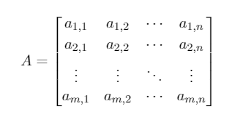
Set Covering Problem (SCP)
SCP aims to minimize the cost of the subset S ⊆ J, with the constraint that all rows i ∈ I are covered by at least one column j ∈ J. Note that when column j is in the subset of solutions S, this is equal to 1, otherwise it corresponds to a 0.
Notes:
SCP tiene como objetivo minimizar el costo del subconjunto S ⊆ J, con la restricción de que todas las filas i ∈ I sean cubiertas por al menos una columna j ∈ J. Hay que tener en cuenta que cuando la columna j está en el subconjunto de soluciones S, esta es igual a 1, en caso contrario corresponde a un 0.

Slide 27
Mathematical model
Objective Function :
Subject to:

Slide 28
Knapsack Problem (KP)
It is classified as an NP-hard problem. Where it is assumed that there is a knapsack with a maximum capacity $C$ and a set of elements $N$. Composed by each object element having a value $p_{i}$ and a weight $w_{i}$. Where we seek to maximize the value of objects stored in the backpack, without exceeding the maximum capacity $C$.
$$C=Capacity$$
N $=Set of elements$
Notes:
Se encuentra catalogado como un problema NP-hard. En donde se asume que se tiene una mochila con una capacidad máxima C y un conjunto de elementos N. Compuesto por cada elemento objeto que tienen un valor p_{i} y un peso w_{i}. Donde se busca maximizar el valor de objetos guardados en la mochila, sin sobrepasar la capacidad máxima C.

Slide 29
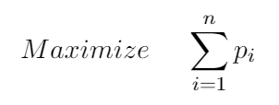
Mathematical model
Objective Function :
Subject to :

Slide 30
Experimental Results

Slide 31
Diversity Determination
$$Div=\frac{1}{l·n}\sum_{d=1}^{l}{\sum_{i=1}^{n}{|{\overline{x}}^{d}−x_{i}^{d}|}}$$
Where:
$Div$: Diversity status determination
${\overline{x}}^{d}$: denotes the mean of the individuals in dimension d.
$x_{i}^{d}$: is the value of the i-th individual of the d-th dimension.
$n$: is the number of individuals in the population
$l$: is the size of the dimensión of the individuals
Hussain, K., Zhu, W., & Salleh, M. N. M. (2019). Long-term memory Harris’ hawk optimization for high dimensional and optimal power flow problems.

Slide 32
State Determination
$$XPL\%=\frac{Div}{Div_{max}}·100, if XPL\%≤50\%$$
$$XPLT\%=\frac{\left|Div−Div_{max}\right|}{Div_{max}}·100, if XPLT\%>50\%$$
Where:
$Div$: is the diversity calculated above
$Div_{max}$: denotes the maximum value of the diversity state found in the whole optimization problem.
Morales-Castañeda, B., Zaldivar, D., Cuevas, E., Fausto, F., & Rodríguez, A. (2020). A better balance in metaheuristic algorithms: Does it exist?.
Notes:
Bernardo Morales-Castañeda, Daniel Zaldivar, Erik Cuevas, FernandoFausto, and Alma Rodríguez. A better balance in metaheuristic algo-rithms: Does it exist?Swarm and Evolutionary Computation, page100671, 2020.

Slide 33
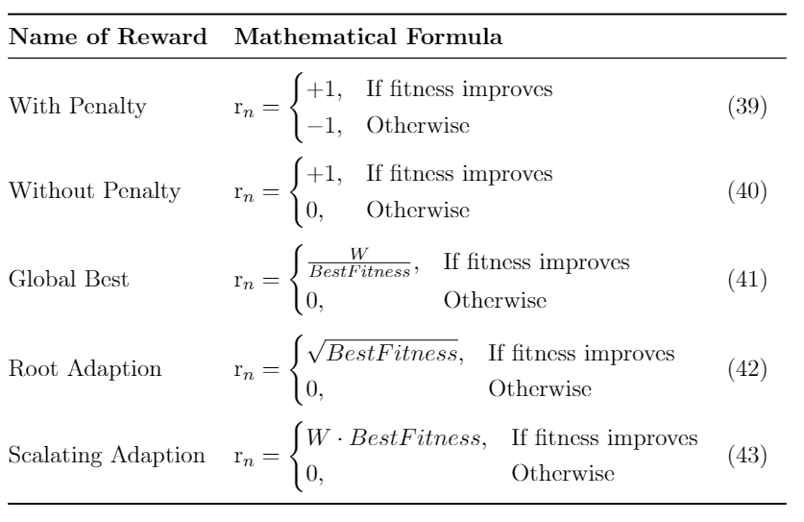
Implementation rewards
Nareyek A. (2003). Choosing search heuristics by non-stationary reinforcement learning.

Slide 34
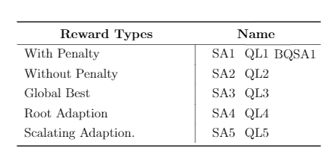
Implementation rewards (IDs)
Lanza-Gutierrez, J. M., Crawford, B., Soto, R., Berrios, N., Gomez-Pulido, J. A., & Paredes, F. (2017). Analyzing the effects of binarization techniques when solving the set covering problem through swarm optimization.
Mirjalili, S., & Lewis, A. (2013). S-shaped versus V-shaped transfer functions for binary particle swarm optimization.

Slide 35
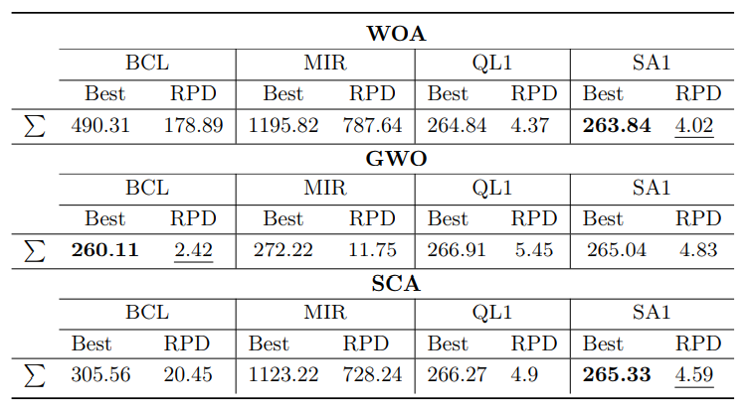
Summary table – SCP with 85 actions

Slide 36
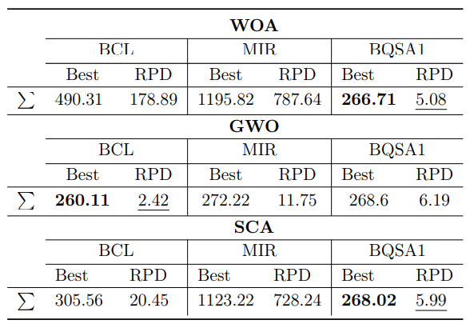
Summary table – SCP with 40 actions

Slide 37
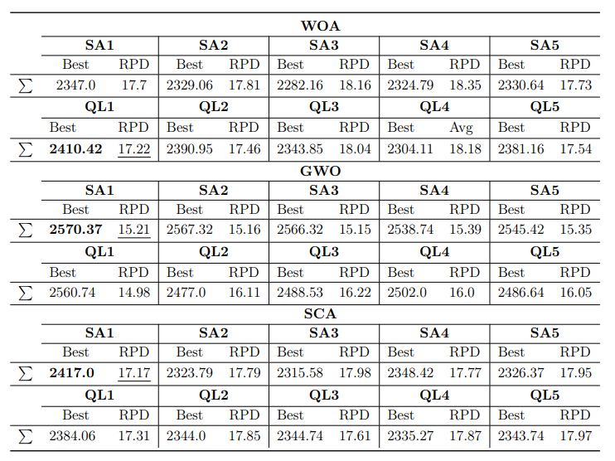
Summary table – 0-1KP

Slide 38
Work Plan
T1: Review existing literature regarding ML techniques improving continuous swarm intelligence MH, binarization techniques and transfer functions.
T2: Implement more transfer functions and binarization techniques, increasing the number of options to choose from with the smart selector.
T3: Implement further ML techniques for binarization scheme selection in a continuous swarm intelligence MH.
T4: Perform experiments and comparisons of the implementations against results of other continuous swarm intelligence MH techniques present in the state of the art, solving combinatorial problems.

Slide 39
Thesis proposal for the next two years
WP1: First Semester
Search more T.F and B.T in the literature (SLR in progress).
Search the literature for other possible intelligent selectors.
Drafting and submitting an SLR
Test the feasibility of comparing Binary Measures Similarity with our way of assessing diversity.
WP2: Second Semester
Algorithmic complexity calculation and description of the software architecture used
Implement more transfer functions and binarization techniques.
Drafting and submitting an article with BQSA and 85 actions.
WP3: Third Semester
Implement the Multi-armed Bandit.
Implement some technique from the ML literature for the selection of binarization schemes.
Search for new ways to represent the data obtained from the experiments.
WP4: Fourth Semester
Obtain all necessary results.
Obtain all necessary graphics.
Obtain all necessary comparisons.
Drafting and submitting an article with Mutil-armed Bandit.

Slide 40
Participation in previous projects
Assistant of the research project DI Investigación Interdisciplinaria del Pregrado 2021. Q-learnheuristics de enjambre para la resolución de problemas combinatoriales.
Assistant of the research project Núcleos de Investigación PUCV - Renovación 2021. Data Analytics.
Assistant of the research project DI Investigación Interdisciplinaria del Pregrado 2020. Metaheurísticas balanceadas guiadas por datos.
Assistant of the research Project DIE – Tesis Innovadoras 2020. MHSolver – Inteligencia Artificial Aplicada a la Optimización de Procesos Logísticos.
Assistant of research Project CONICYT/FONCEDYT Regular Nº 1210810. Data-driven ambidextrous metaheuristics: using machine learning approaches to manage balance of exploration and exploitation when solving combinatorial problems with continuous swarm intelligence algorithm. 2020 – To present.

Slide 41
Previous works and Publications
Lemus-Romani, J., Becerra-Rozas, M., Crawford, B., Soto, R., Cisternas-Caneo, F., Vega, E., ... & García, J. (2021). A Novel Learning-Based Binarization Scheme Selector for Swarm Algorithms Solving Combinatorial Problems. (WoS) (Q1)
Crawford, B., Soto, R., de la Fuente Mella, H., Elortegui, C., Palma, W., Torres-Rojas, C., Vasconcellos-Gaete, C., Becerra-Rozas, M., Peña, J. & Misra, S. (In proceeding) Binary Fruit Fly Swarm Algorithms for the Set Covering Problem. (WoS)(Q2)
Crawford, B., Soto, R., Lemus-Romani, J., Becerra-Rozas, M., Lanza-Gutiérrez, J. M., Caballé, N., ... & Rubio, J. M. (2021). Q-learnheuristics: Towards data-driven balanced metaheuristics. (WoS)(Q1)
García, J., Lemus-Romani, J., Altimiras, F., Crawford, B., Soto, R., Becerra-Rozas, M., ... & Astorga, G. (2021). A binary machine learning cuckoo search algorithm improved by a local search operator for the set-union knapsack problem. (WoS) (Q1)
Becerra-Rozas, M., Lemus-Romani, J., Crawford, B., Soto, R., Cisternas-Caneo, F., Embry, A. T., ... & Rubio, J. M. (In proceeding) A New Learnheuristic: Binary SARSA - Sine Cosine Algorithm (BS-SCA) (Scopus)
Becerra-Rozas, M., Lemus-Romani, J., Crawford, B., Soto, R., Cisternas-Caneo, F., Embry, A. T., ... & Rubio, J. M. (2021, September). Reinforcement Learning Based Whale Optimizer. (Scopus)
Tapia, D., Crawford, B., Soto, R., Palma, W., Lemus-Romani, J., Cisternas-Caneo, F., ... & Misra, S. (2021, March). Embedding Q-Learning in the selection of metaheuristic operators: The enhanced binary grey wolf optimizer case. (Scopus)
Cisternas-Caneo, F., Crawford, B., Soto, R., Tapia, D., Lemus-Romani, J., Castillo, M., ... & Misra, S. (2020, December). A data-driven dynamic discretization framework to solve combinatorial problems using continuous metaheuristics. (Scopus)
Crawford, B., Soto, R., Cisternas-Caneo, F., Tapia, D., Palma, W., Lemus-Romani, J., ... & Becerra-Rozas, M. (2021, June). A Comparison of Learnheuristics Using Different Reward Functions to Solve the Set Covering Problem. (Scopus)

Slide 42
A SELF-LEARNING METAHEURISTIC FRAMEWORK BASED ON REINFORCEMENT LEARNING FOR COMBINATORIAL PROBLEM
Marcelo Becerra Rozas imaberro90@gmail.com
Facultad de Ingeniería Escuela de Ingeniería Informática
Examen de Grado - Candidatura
Valparaíso, Enero 2022

Slide 43
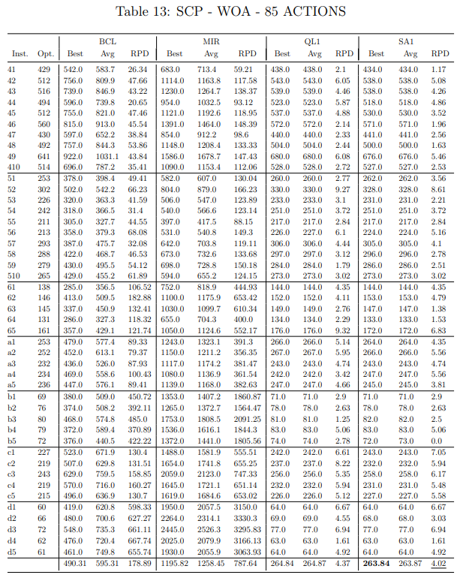

Slide 44
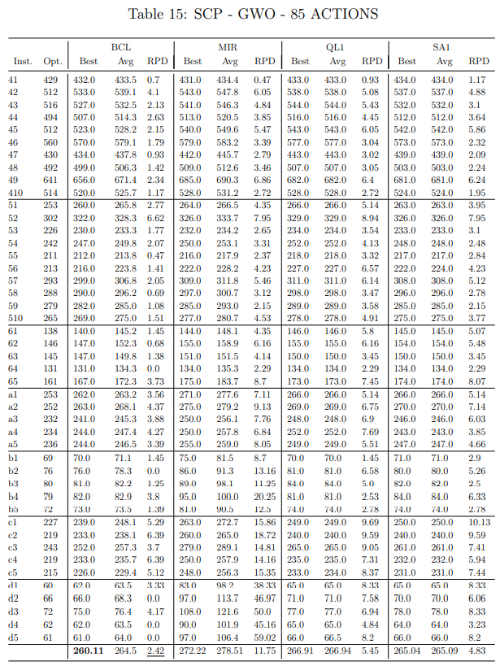

Slide 45
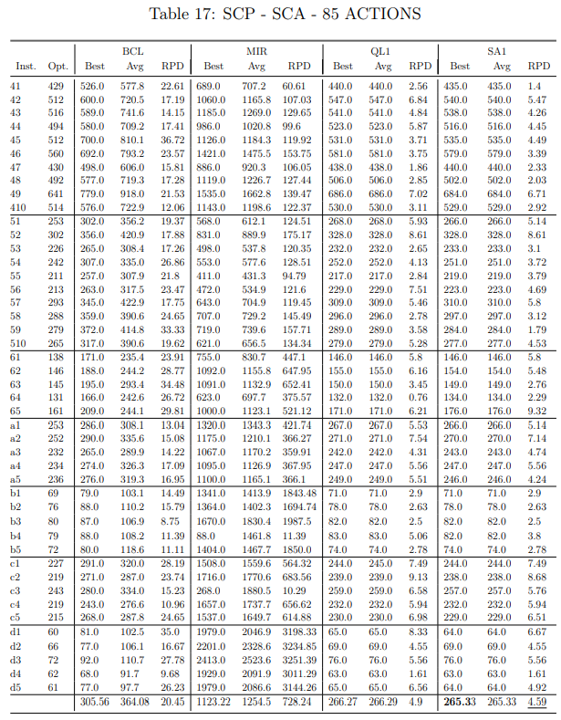

Slide 46
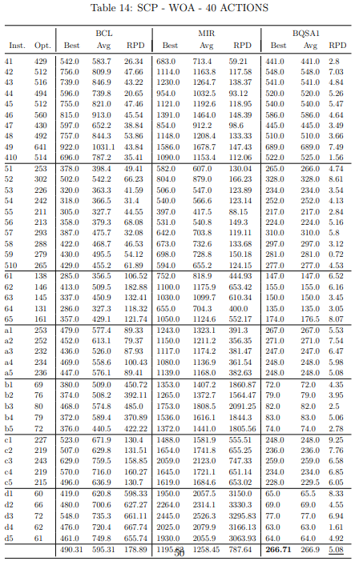

Slide 47
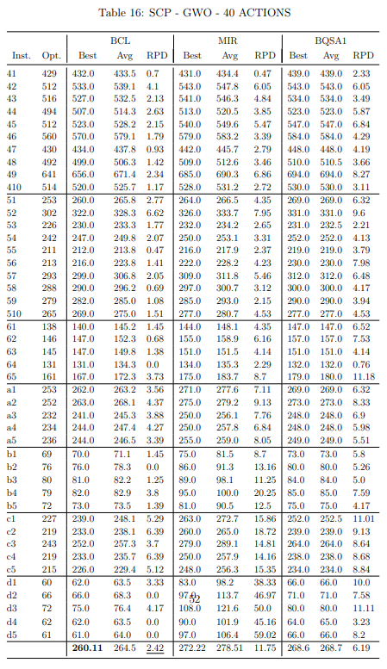

Slide 48
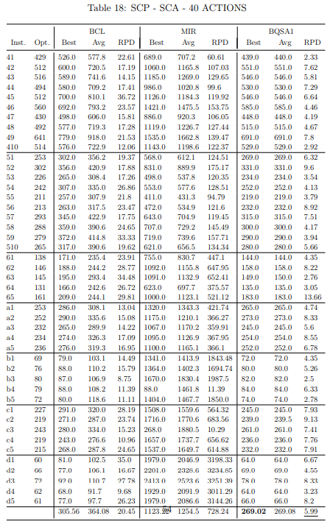

Slide 49
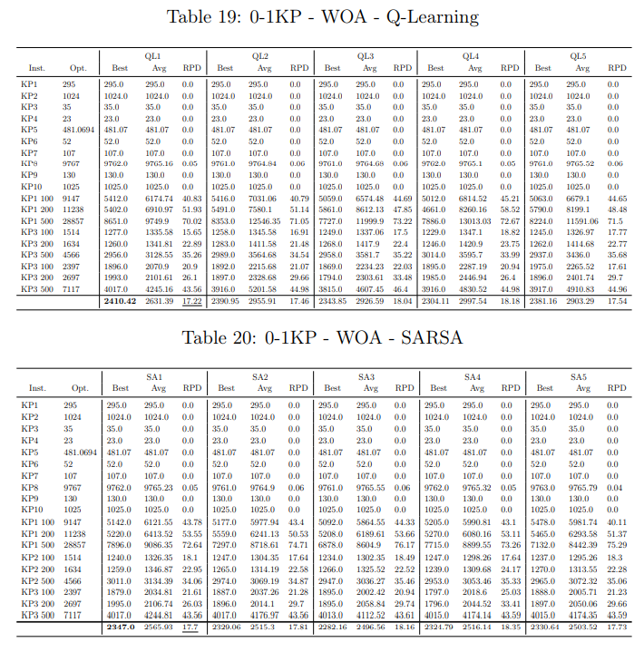

Slide 50
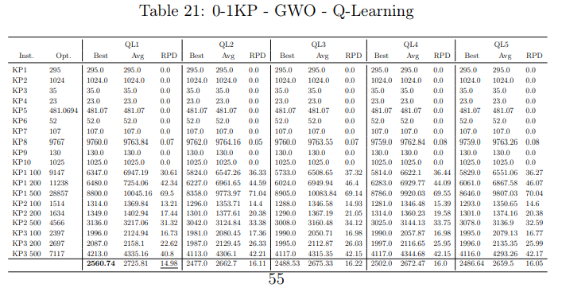
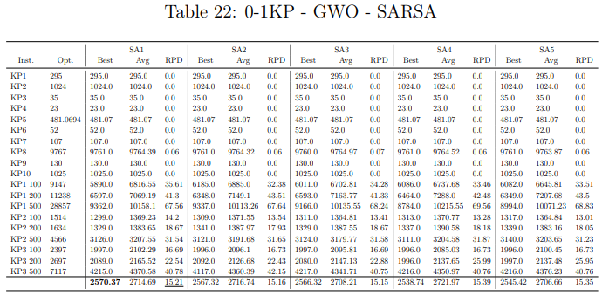

Slide 51
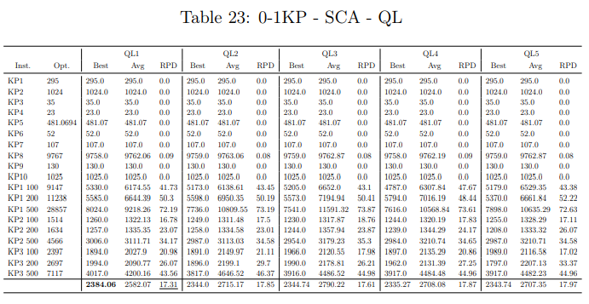
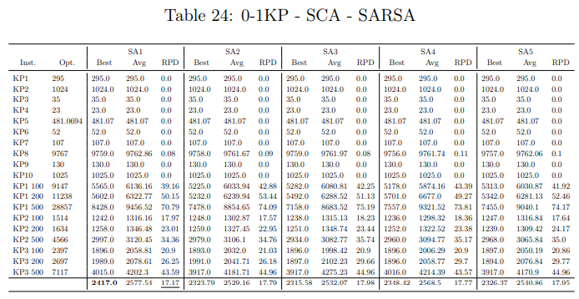

Slide 52
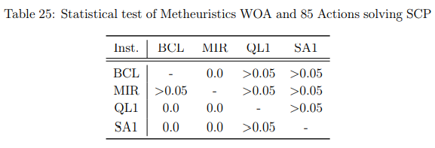
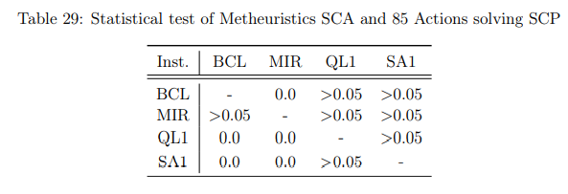
Statical test of SCP

Slide 53
Statical test of SCP

Slide 54
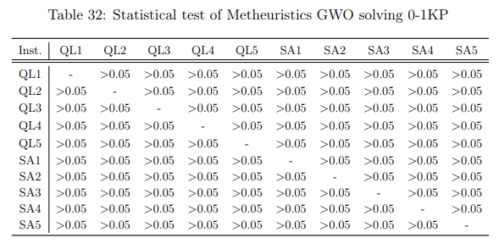
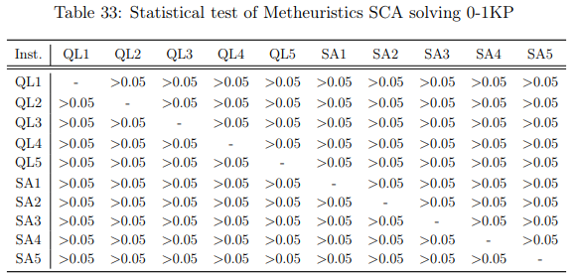
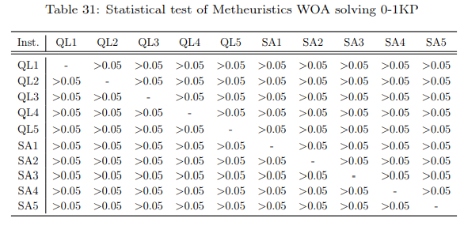
Statical test of 0-1KP

Slide 55
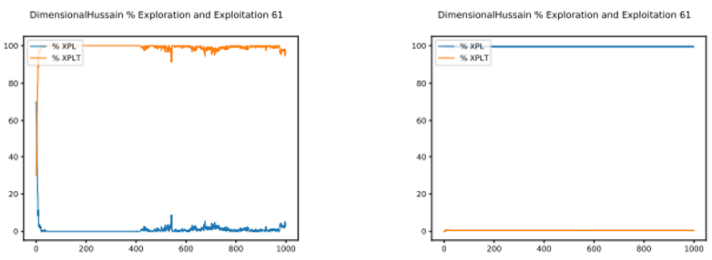
Exploration-Exploitation Graphics of SCP – WOA-BCL/WOA-MIR

Slide 56
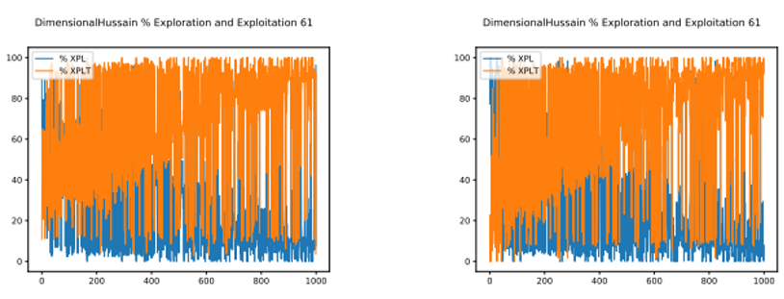
Exploration-Exploitation Graphics of SCP – WOA-QL/WOA-SARSA

Slide 57
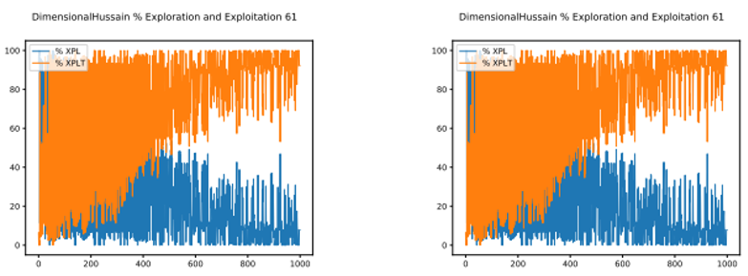
Exploration-Exploitation Graphics of SCP – WOA-BQSA

Slide 58
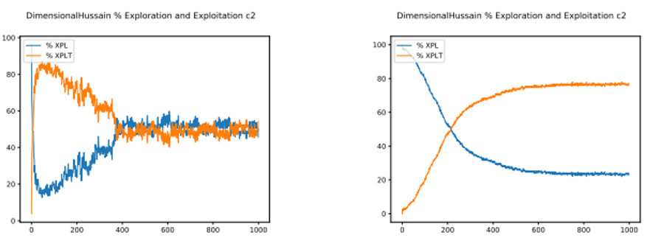
Exploration-Exploitation Graphics of SCP – GWO-BCL/GWO-MIR

Slide 59
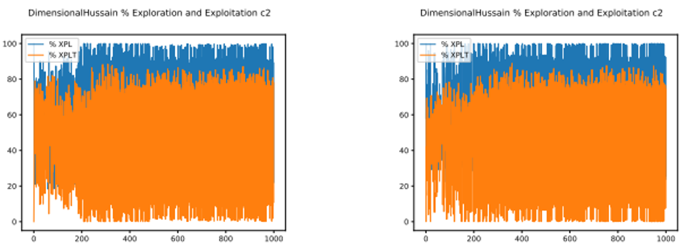
Exploration-Exploitation Graphics of SCP – GWO-QL/GWO-SARSA

Slide 60
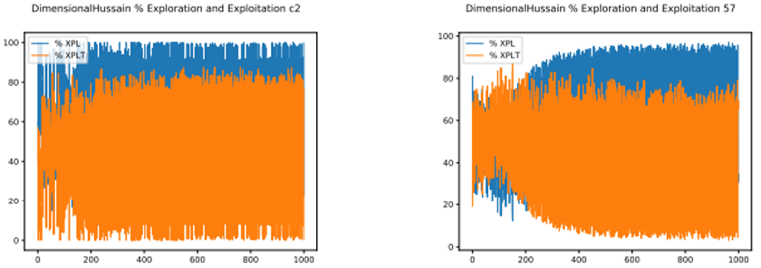
Exploration-Exploitation Graphics of SCP – GWO-BQSA

Slide 61
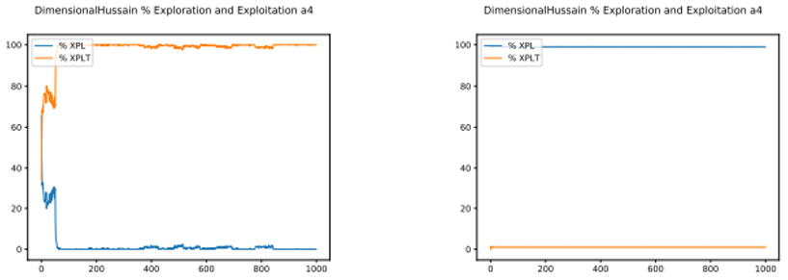
Exploration-Exploitation Graphics of SCP – SCA-BCL/SCA-MIR

Slide 62
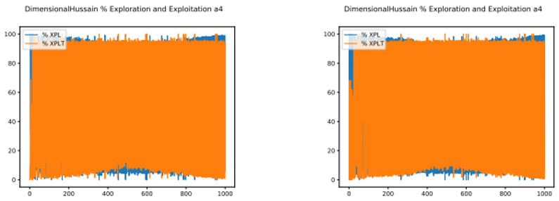
Exploration-Exploitation Graphics of SCP – SCA-QL/SCA-SARSA

Slide 63
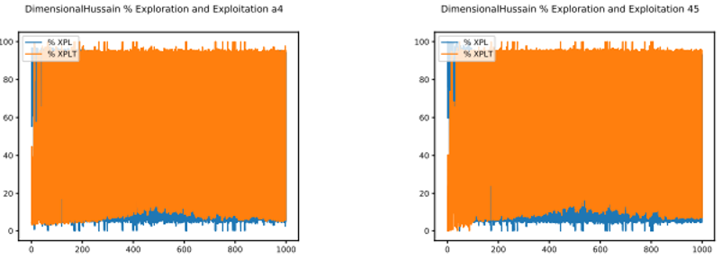
Exploration-Exploitation Graphics of SCP – SCA-BQSA

Slide 64
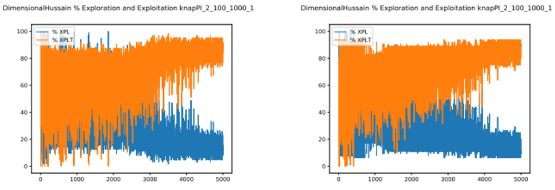
Exploration-Exploitation Graphics of 0-1KP – WOA-QL/WOA-SARSA

Slide 65
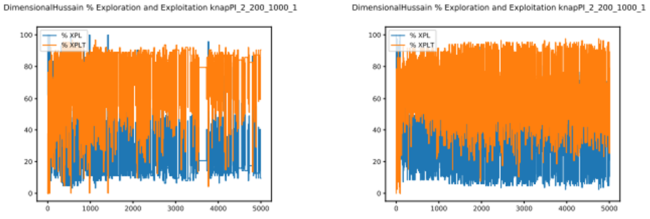
Exploration-Exploitation Graphics of 0-1KP – GWO-QL/GWO-SARSA

Slide 66
Exploration-Exploitation Graphics of 0-1KP – SCA-QL/SCA-SARSA

Slide 67
Types O
Actions that can be taken
Types Z
Types X
Types S
Types V

Slide 68
Actions that can be taken
Types S
Types V

Slide 69
Action Graphics of SCP with 85 actions

Slide 70
Action Graphics of SCP with 85 actions

Slide 71
Action Graphics of SCP with 40 actions

Slide 72
Action Graphics of SCP with 40 actions

Slide 73
U-Shaped
Mirjalili, S., Zhang, H., Mirjalili, S., Chalup, S., & Noman, N. (2020). A Novel U-Shaped Transfer Function for Binary Particle Swarm Optimisation.

Slide 74
Time Varying
Chantar, H., Thaher, T., Turabieh, H., Mafarja, M., & Sheta, A. (2021). BHHO-TVS: A Binary Harris Hawks Optimizer with Time-Varying Scheme for Solving Data Classification Problems.
Mafarja, M., Aljarah, I., Heidari, A. A., Faris, H., Fournier-Viger, P., Li, X., & Mirjalili, S. (2018). Binary dragonfly optimization for feature selection using time-varying transfer functions.

Slide 75
Time Varying
Islam, M. J., Li, X., & Mei, Y. (2017). A time-varying transfer function for balancing the exploration and exploitation ability of a binary PSO.
Kahya, M. A., Altamir, S. A., & Algamal, Z. Y. (2021). Improving whale optimization algorithm for feature selection with a time-varying transfer function.

Slide 76
Whale Optimization Algorithm (WOA)
$$For Iter \left(t\right): \\ −−−For Solución \left(x\right):$$
$−−−For Dimensión \left(d\right):$ $if \left(p<0.5\right)then$
$if \left(\left|A\right|<1\right) then$ $Eq. 20$ $else \left(\left|A\right|≥1\right) then$ $Eq. 18$ $else \left(p≥0.5\right)$ $Eq. 21$ $t=t+1$
$C=2·r$
$$r=[0, 1]$$
$X_{d}^{t+1}={X^{∗}}_{d}^{t}−A·D$
$D= \left|C·{X^{∗}}_{d}^{t}−X_{d}^{t}\right|$
$X_{d}^{t+1}=X_{Rand}^{t} −A·D$
$D= \left|C·X_{Rand}^{t}−X^{t}\right|$
$X_{d}^{t+1}=D′·e^{bl}·\cos\left(2πl\right)+{X^{∗}}_{d}^{t}$
$D^{′}= \left|{X^{∗}}_{d}^{t}−X_{d}^{t}\right|$
$$Return X^{∗}$$
PRESA
$A=2·a·r −a$
$$p=[0, 1]$$
$$0$$
$$2$$
PRESA

Slide 77
Grey Wolf Optimization (GWO)
$$For Iter in \left(t\right):$$
$Set a=2 −t∗\left(\frac{2}{T}\right)$ $$−−−For solution in \left(x\right):$$
$−−−For dimension in \left(d\right):$ $Update position with Eq. 26$
$Update A and C$
$Calculate fitness of population$
$Update X_{α}, X_{β}, X_{δ}$
$t=t+1$
$A=2a·r_{1}−a Eq. 25$
$C=2·r_{2} Eq. 25$
$D= \left|C·{X_{p}}_{d}^{t}−X_{d}^{t}\right| Eq. 24$
$X_{d}^{t+1}={X_{p}}_{d}^{t}−A·D Eq.23$
${X_{p}}_{d}^{t+1}= \frac{X_{1}+X_{2}+X_{3}}{3}$
$$Return Best Solution$$

Slide 78
Grey Wolf Optimization (GWO)
It is a population-based metaheuristic that is inspired by the behavior of gray wolves and their hierarchy when searching for and hunting their prey.
A. Pursuit, approach and tracking
B-C-D. Tracking, harassing and encircling.
E. Atack

Slide 79
Sine-Cosine Algorithm (SCA)
Population-based metaheuristic inspired by the fluctuation that solutions have when following a mathematical model based on sine and cosine functions.

Slide 80
Machine Learning

Slide 81
General Q-Learning Equation
Select the maximum action
$$Q_{n}\left(s_{t},a_{t}\right)=Q_{n−1}\left(s_{t−1},a_{t−1}\right)+α[r_{n}+ γ⋅{\max_{a} Q}_{n+1}\left(s_{t+1},a_{t+1}\right)−Q_{n}(s_{t},a_{t})]$$
Previous value
Learning factor($α$):
Indicates the importance of the information previously obtained.
$α∈(0,1)$
Reward($r_{n}$):
Indicates the penalty or reward value of the action.
$r_{n}∈ ℝ$
Discount factor($γ$):
It functions as a scaling factor to reward or punish in the current action.
$γ∈(0,1)$

Slide 82
SARSA General Equation
Discount factor
$$Q_{n}\left(s_{t},a_{t}\right)=Q_{n−1}\left(s_{t−1},a_{t−1}\right)+α[r_{n}+ γ⋅Q_{n+1}\left(s_{t+1},a_{t+1}\right)−Q_{n−1}(s_{t−1},a_{t−1})]$$
Previous Value
Reward
Value of the following state
Learning factor($α$):
Indicates the importance of the information previously obtained.
$α∈(0,1)$
Reward($r_{n}$):
Indicates the penalty or reward value of the action.
$r_{n}∈ ℝ$
Discount factor($γ$):
It functions as a scaling factor to reward or punish in the current action.
$γ∈(0,1)$

Slide 83
Difference between SARSA and QL
Mouse vs Cliff:
In the present scenario the red squares are shown as a cliff, the blue square as the mouse and the green square as the cheese.

Slide 84
Ejemplo para diferenciar SARSA y QL
Using QL :

Slide 85
Ejemplo para diferenciar SARSA y QL
Using SARSA:

